Slide 1
Assignment 5.2 Charts
DSC640
Taniya Adhikari

Slide 2
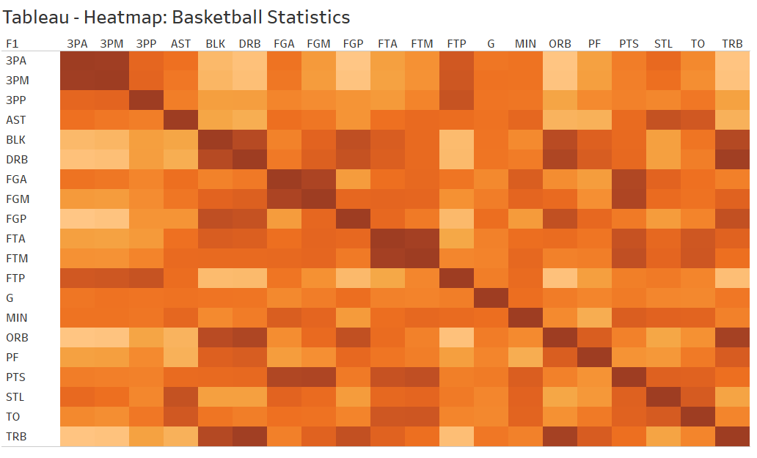
Tableau – Heat Map

Slide 3
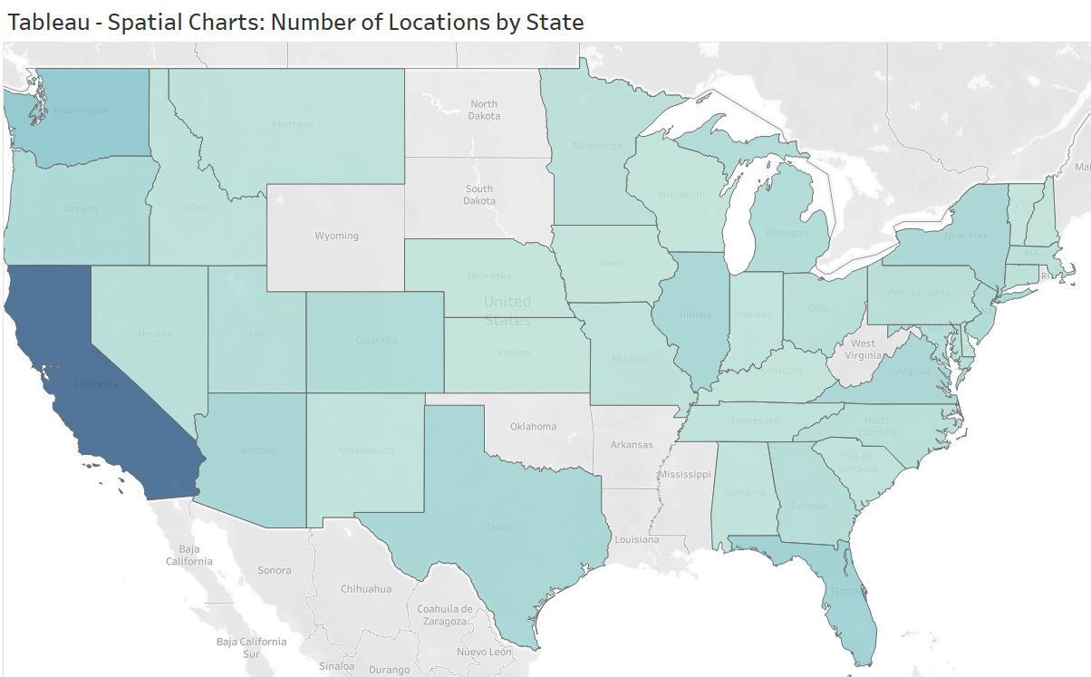
Tableau – Spatial Charts

Slide 4
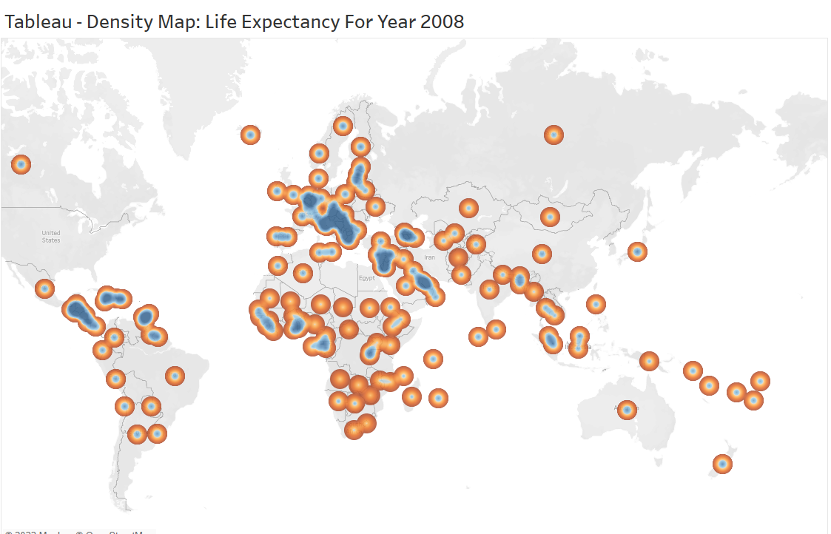
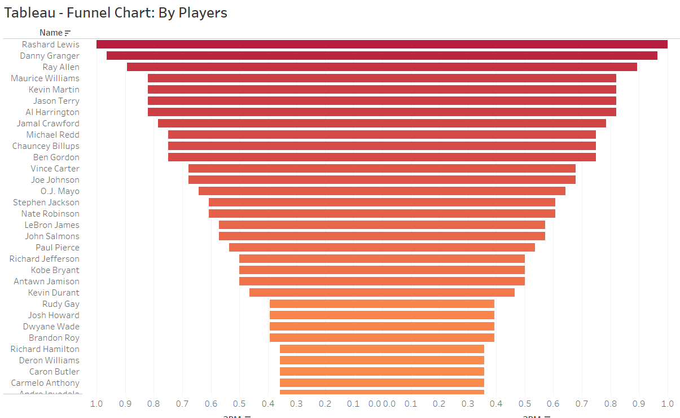
Tableau – Funnel Charts

Slide 5
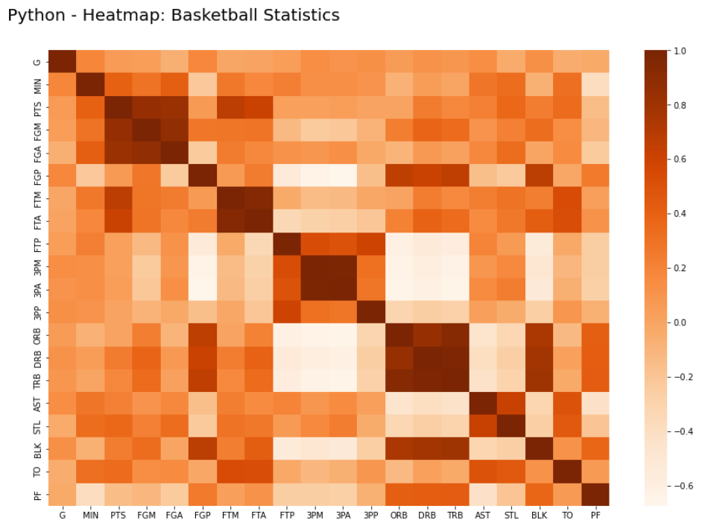
Python – Heat Map

Slide 6
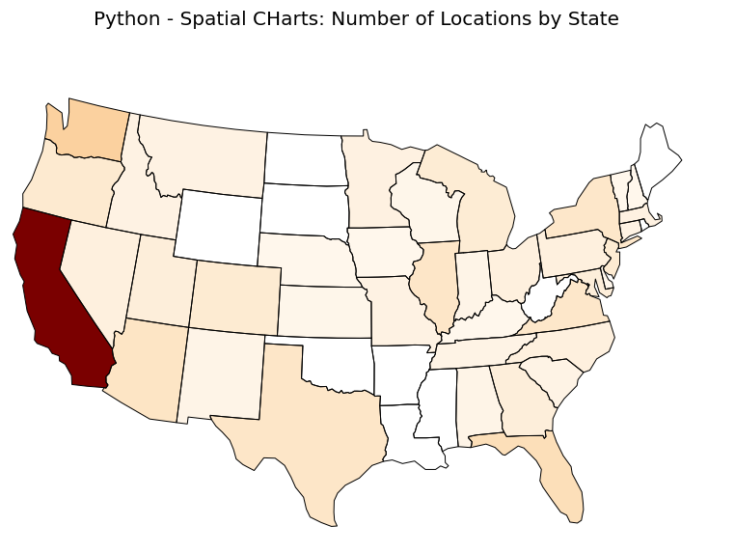
Python – Spatial Chart

Slide 7
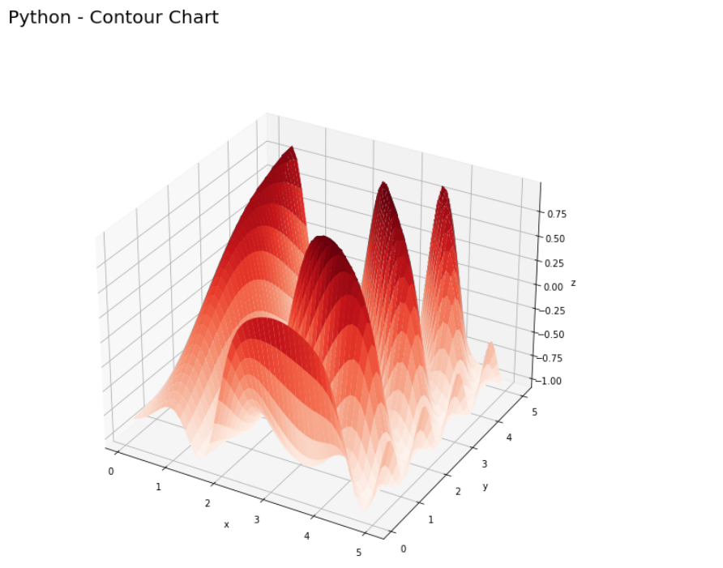
Python – Contour Chart

Slide 8
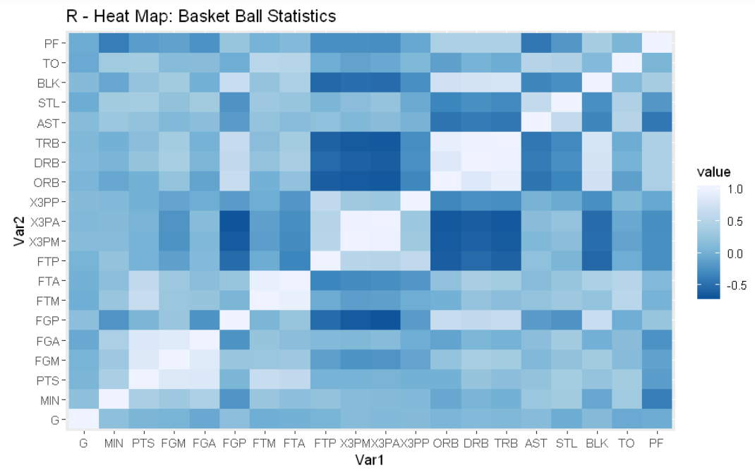
R– Heat Map

Slide 9
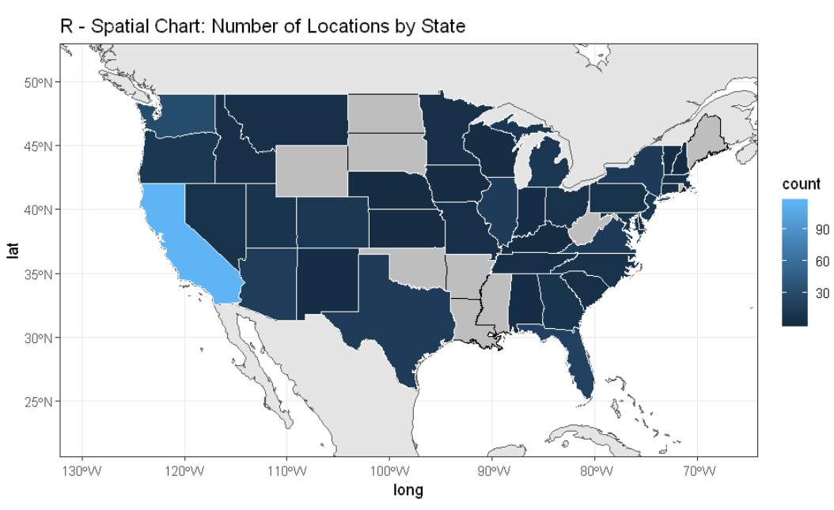
R – Spatial Chart

Slide 10
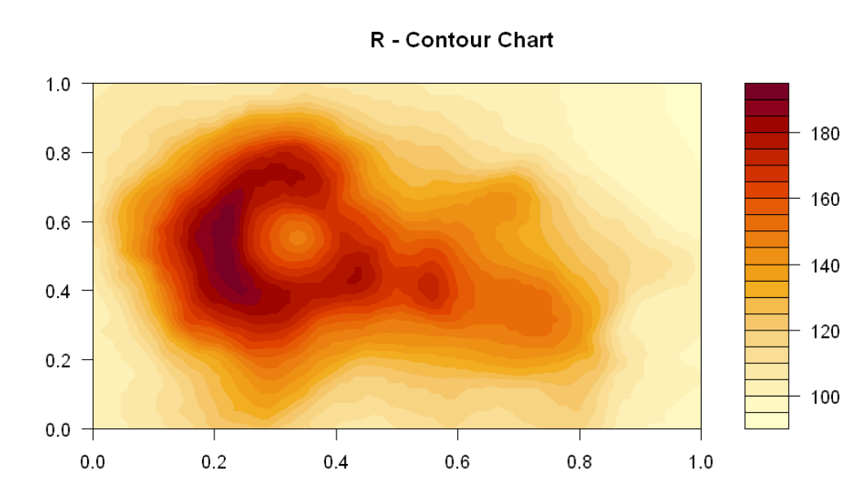
R – Contour Chart

Slide 11
Supplemental Files
Tableau Screenshot
Python Code
R Code

Slide 12
